Slide 1
Overfitting & Its Avoidance
Presenter: Sie Siong Wong
DATA 607 – Fall 2019

Slide 2
What are Training, Validation, Holdout?
Training set: subsection of a dataset to uncover or learn relationships between features and the target variable.
Validation set: another subset used to see how accurately a model identifies relationships between the known outcomes for the target variable and the dataset’s other features.
Holdout set: referred to as testing data, provides final estimate of model’s performance it has been trained and validated.
Notes:
Before we’re getting into the key topic today overfitting, let’s talk about partitioning data into training, validation, and holdout sets. This is the first step in developing a model says machine learning model, in order to train and validate a model. The training set is subsection of a dataset to uncovers or learns relationships between features and the target variable…….

Slide 3
What are Training, Validation, Holdout? Cont.
Why they’re so important?
allows you to develop highly accurate models that are relevant to data that you collect in the future, not just the data the model was trained on.
get a real sense of how accurate the model’s outcomes will be, leading to better decisions and greater confidence in your model’s accuracy.
Notes:
Partitioning data into training, validation, and holdout sets allows you to develop highly accurate models that are relevant to data that you collect in the future, not just the data the model was trained on. By training your data, validating it, and testing it on the holdout set, you get a real sense of how accurate the model’s outcomes will be, leading to better decisions and greater confidence in your model’s accuracy.

Slide 4
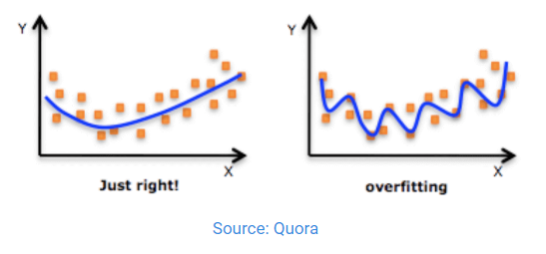
Overfitting
Happens when a model has become too attuned to the data on which it was trained and therefore loses its applicability to any other dataset.
Notes:
Overfitting happens when a machine learning model has become too attuned to the data on which it was trained and therefore loses its applicability to any other dataset. The model is so specific to the original data that trying to apply it to data collected in the future would result in problematic or erroneous outcomes and therefore less-than-optimal decisions. The figure shows the difference between a properly fitted and overfitted model. The overfitted model is not going to be useful unless we apply it to the exact same dataset because no other data will fall exactly along the overfitted line.

Slide 5
Overfitting (Cont.)
There is no single choice or technique to eliminate overfitting.
Best Strategy : recognize overfitting by testing with a holdout set.
Notes:
Several types of curves can help detect and measure overfitting.

Slide 6
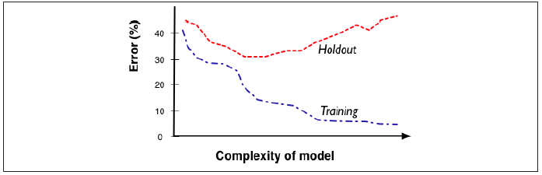
Overfitting (Cont.)
Source: Provost, F., & Fawcett, T. (2013)
This fitting graph has two curves showing the model performance on the training and testing data as a function of model complexity.
Notes:
The accuracy starts off low when the model is simple, increases as complexity increases. Accuracy estimates on training data and testing data vary differently based on how complex we allow a model to be. When the model is not allowed to be complex enough, it is
not very accurate. As the models get too complex, they look very accurate on the training data, but in fact are overfitting—the training accuracy diverges from the holdout (generalization) accuracy.

Slide 7
Overfitting Cont.
Why overfitting is bad?
Overfitting causes the model to misrepresent the data it learned from.
A model that only memorizes is useless because it always overfits and is incapable of generalizing.
Spurious correlations are idiosyncracies of the specific training set used and do not represent characteristics of the population in general. They produce incorrect generalizations in the model and causes performance to decline.
Notes:
Overfitting causes the model to misrepresent the data it learned from. A model that only memorizes is useless because it always overfits and is incapable of generalizing. An overfitted model will be less accurate on new, similar data than a model which is more generally fitted, but the overfitted one will appear to have a higher accuracy when you apply it to the training data. Spurious correlations are idiosyncracies of the specific training set used and do not represent characteristics of the population in general. They produce incorrect generalizations in the model and causes performance to decline.

Slide 8
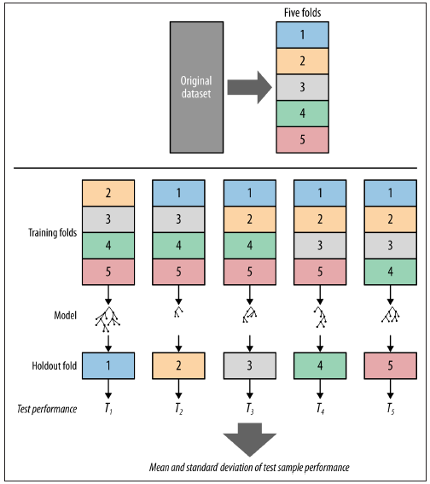
K-fold Cross Validation
Source: Provost, F., & Fawcett, T. (2013)
Notes:
The K-fold cross validation is one way to improve over the single holdout method. The figure shows five-fold cross-validation. The original dataset is split randomly into five equal-sized pieces. Then, each piece is used in turn as the test set, with the other four used to train a model. The result is five different accuracy results, which then can be used to compute the average accuracy and its variance.

Slide 9
Overfitting Avoidance
Regularization:
Tree Pruning: cutting a classification tree back when it has become too large.
Feature selection: sequential forward selection (SFS)
Employed explicit complexity penalties into the objective function used for modeling.
Notes:
The general method for reining in model complexity to avoid overfitting is called model regularization. Techniques include tree pruning (cutting a classification tree back when it has become too large), feature selection, and employing explicit complexity penalties into the objective function used for modeling.
Pruning: cut off leaves and branches, replacing them with leaves. One general idea is to estimate whether replacing a set of leaves or a branch with a leaf would reduce accuracy. If not, then go ahead and prune. The process can be iterated on progressive subtrees until any removal or replacement would reduce accuracy.
Sequential forward selection (SFS) of features uses a nested holdout procedure to first pick the best individual feature, by looking at all models built using just one feature. After choosing a first feature, SFS tests all models that add a second feature to this first chosen feature. The best pair is then selected. Next the same procedure is done for three, then four, and so on. When adding a feature does not improve classification accuracy on the validation data, the SFS process stops.

Slide 10

Devastating 2011 Earthquake in Japan
Fukushima nuclear reactors were built to withstand a magnitude 8.6 earthquake.
Source: Business Insider
Notes:
I believe everyone knows the devastating 2011 earthquake in Japan. Fukushima nuclear plant was built to withstand a magnitude 8.6 earthquake.

Slide 11

Devastating 2011 Earthquake in Japan (Cont.)
A magnitude 9.1 earthquake occurred!
Source: The Guardian
Notes:
But a magnitude 9.1 earthquake occurred. This was never expected. It was the most powerful earthquake ever recorded in Japan.

Slide 12
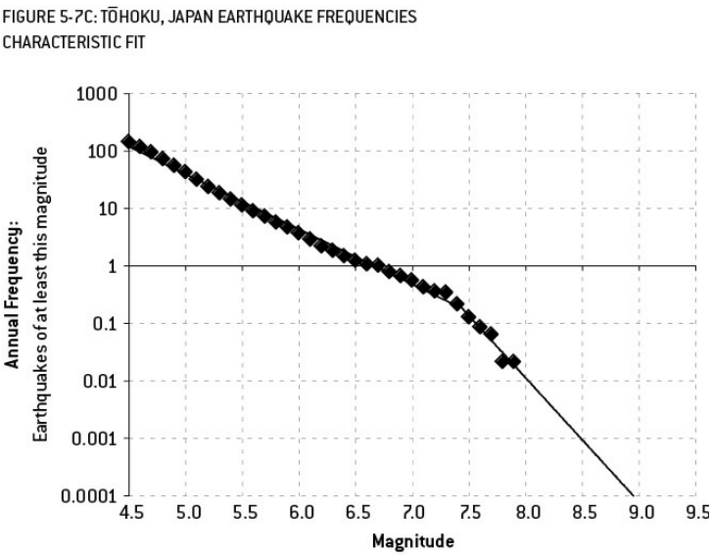
Devastating 2011 Earthquake in Japan (Cont.)
Source: Silver, N. (2012)
Notes:
This figure is historical frequencies of earthquakes before the 2011 earthquake. There is no earthquake as large as a magnitude 8.0 in the region since 1964. This graph used by seismologists suggests that magnitude 9.1 earthquake was nearly impossible because if based on the plot it might occur about every 13,000 year. This type of pattern-matching is not always a good thing—it could imply an overfit model, in which case it will do a worse job of matching the true relationship. In this case, an overfit model would dramatically underestimate the likelihood of a catastrophic earthquake in the area.

Slide 13
Reference
Provost, F., & Fawcett, T. (2013). Data Science for Business: What You Need to Know About Data Mining and Data-Analytic Thinking (1st ed.). California: O’Reilly Media, Inc.
Silver, N. (2012). The Signal and the Noise: Why So Many Predictions Fail-but Some Don't (1st ed.). New York: Penguin Group.
DataRobot. (2019). Overfitting. Retrieved from https://www.datarobot.com/wiki/overfitting/

Slide 14

Thank You for Listening

